Slide 1
IDENTIFY ARTIST FROM ART BASED ON NEURAL NETWORKS
-----------------------------------------------------------------------
Images Classification Problem
Group 3:
Siqi Jiang
Yunyun Jiang
Jing Li

Slide 2
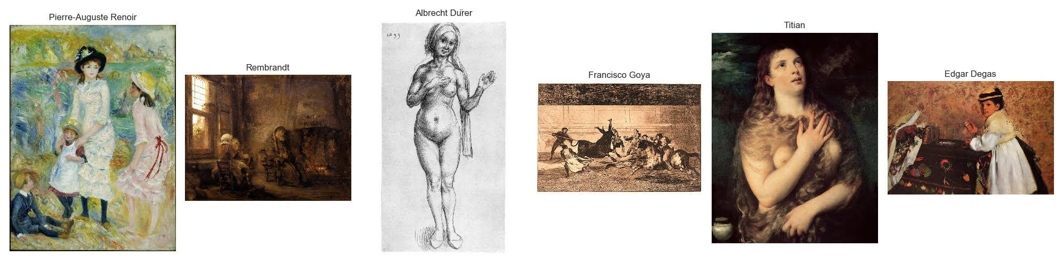
Introduction
Goal : Using the magic of Deep Learning to create models to identify who the genius is behind a mind-blowing painting.
Questions: Can you tell that the following 6 paintings are from different artists?

Slide 3
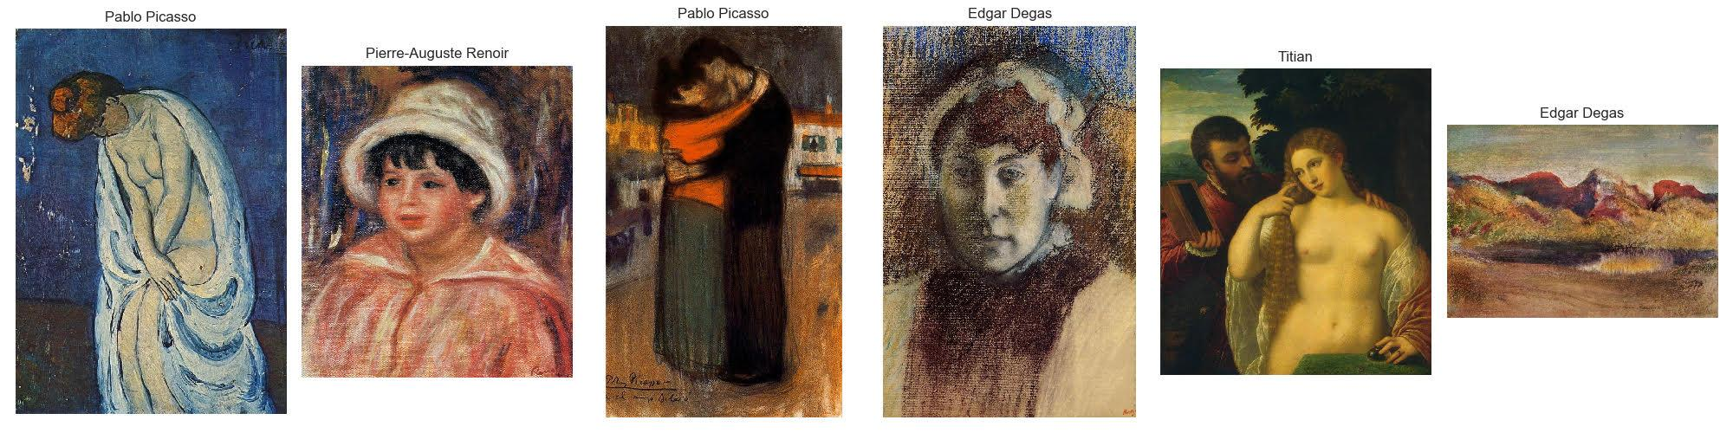
Introduction
How about now? Could you still get a firmed answer easily? As amateurs of art, it is not easy for us. However, with the neural network models, identifying is going to be easy.

Slide 4
Dataset
This dataset contains three files:
artists.csv: dataset of information for each artist
images.zip: collection of images (full size), divided in 50 folders, one for each artist and sequentially numbered
resized.zip: same collection but images have been resized and extracted from folder structure
The columns listed in the csv file:
# Id # name # years # genre
# bio # nationality # wikipedia # paintings

Slide 5
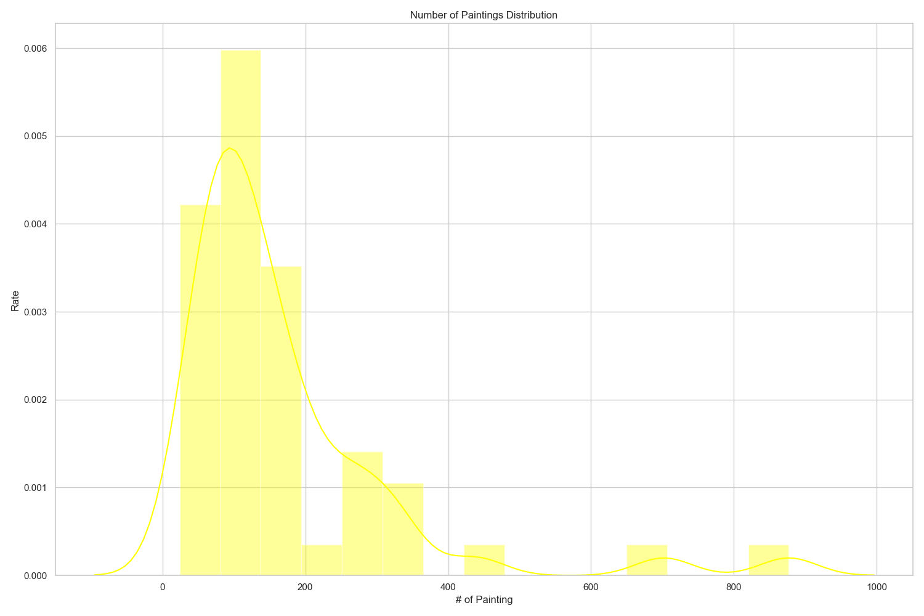
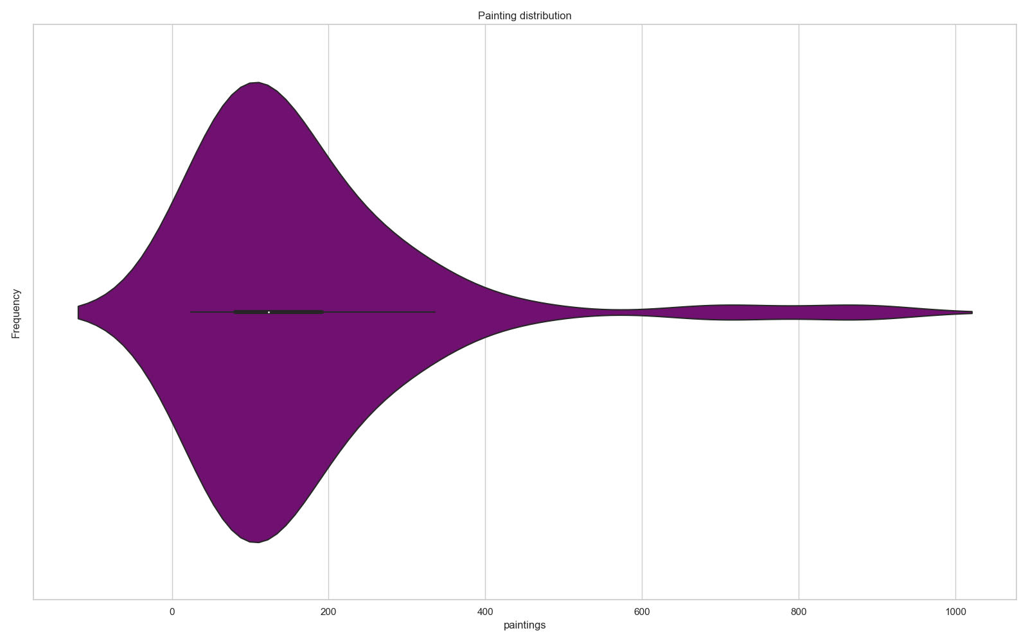
EDA -- Number of Paintings
These 2 plots are paintings distribution.
The average number of paintings of an artists in his lifetime is 168.
Two outliers are Vincent van Gogh and Edgar Degas, who created 877 and 701 oil paintings respectively.

Slide 6
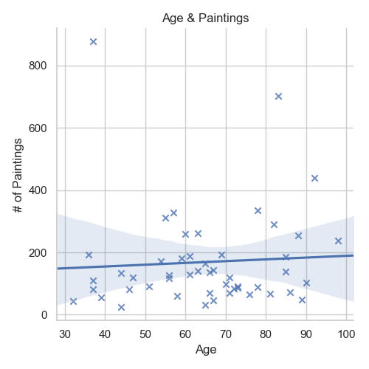
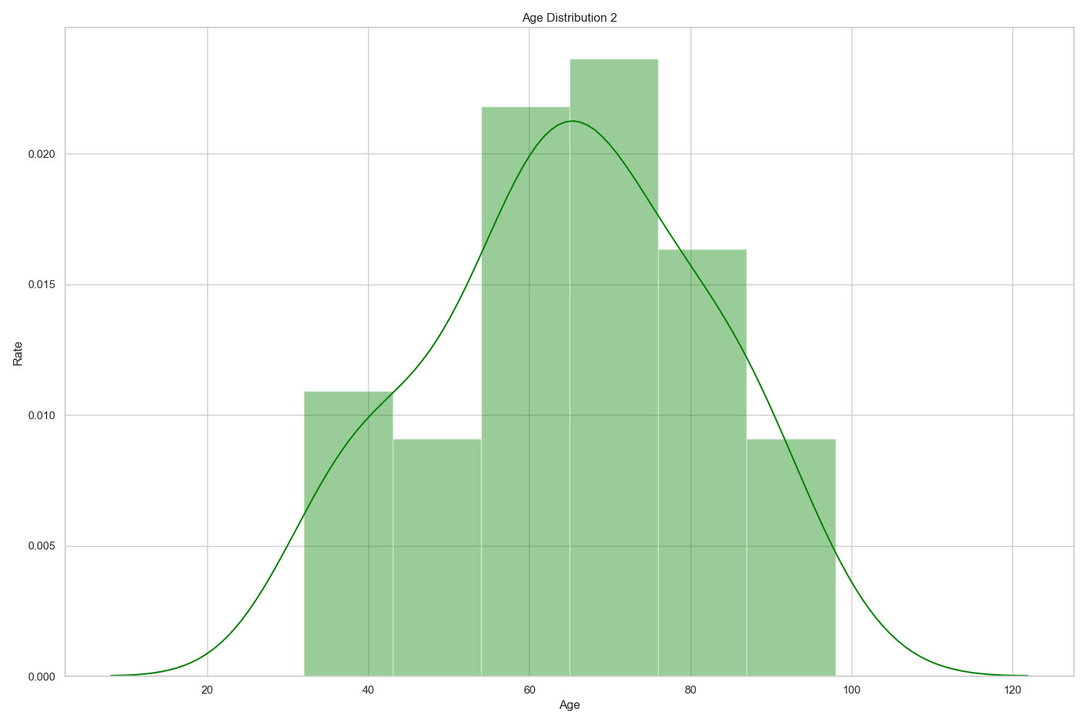
EDA -- Age
The left plot is age distribution closes to a normal distribution
The right plot is relation between age and number of paintings. It looks like a simple linear regression. The two outliers, Vincent van Gogh and Edgar Degas, are clearly showing on this plot.

Slide 7
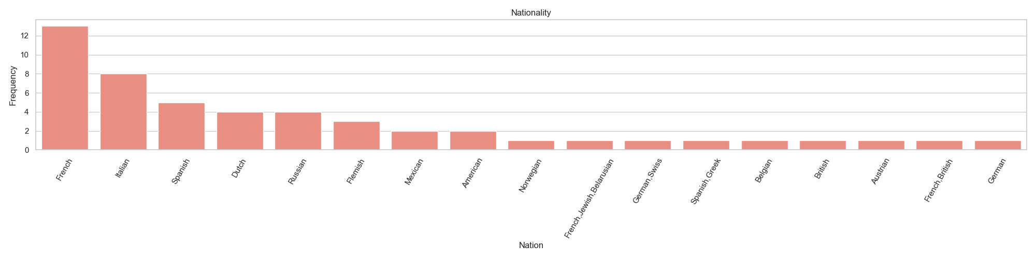
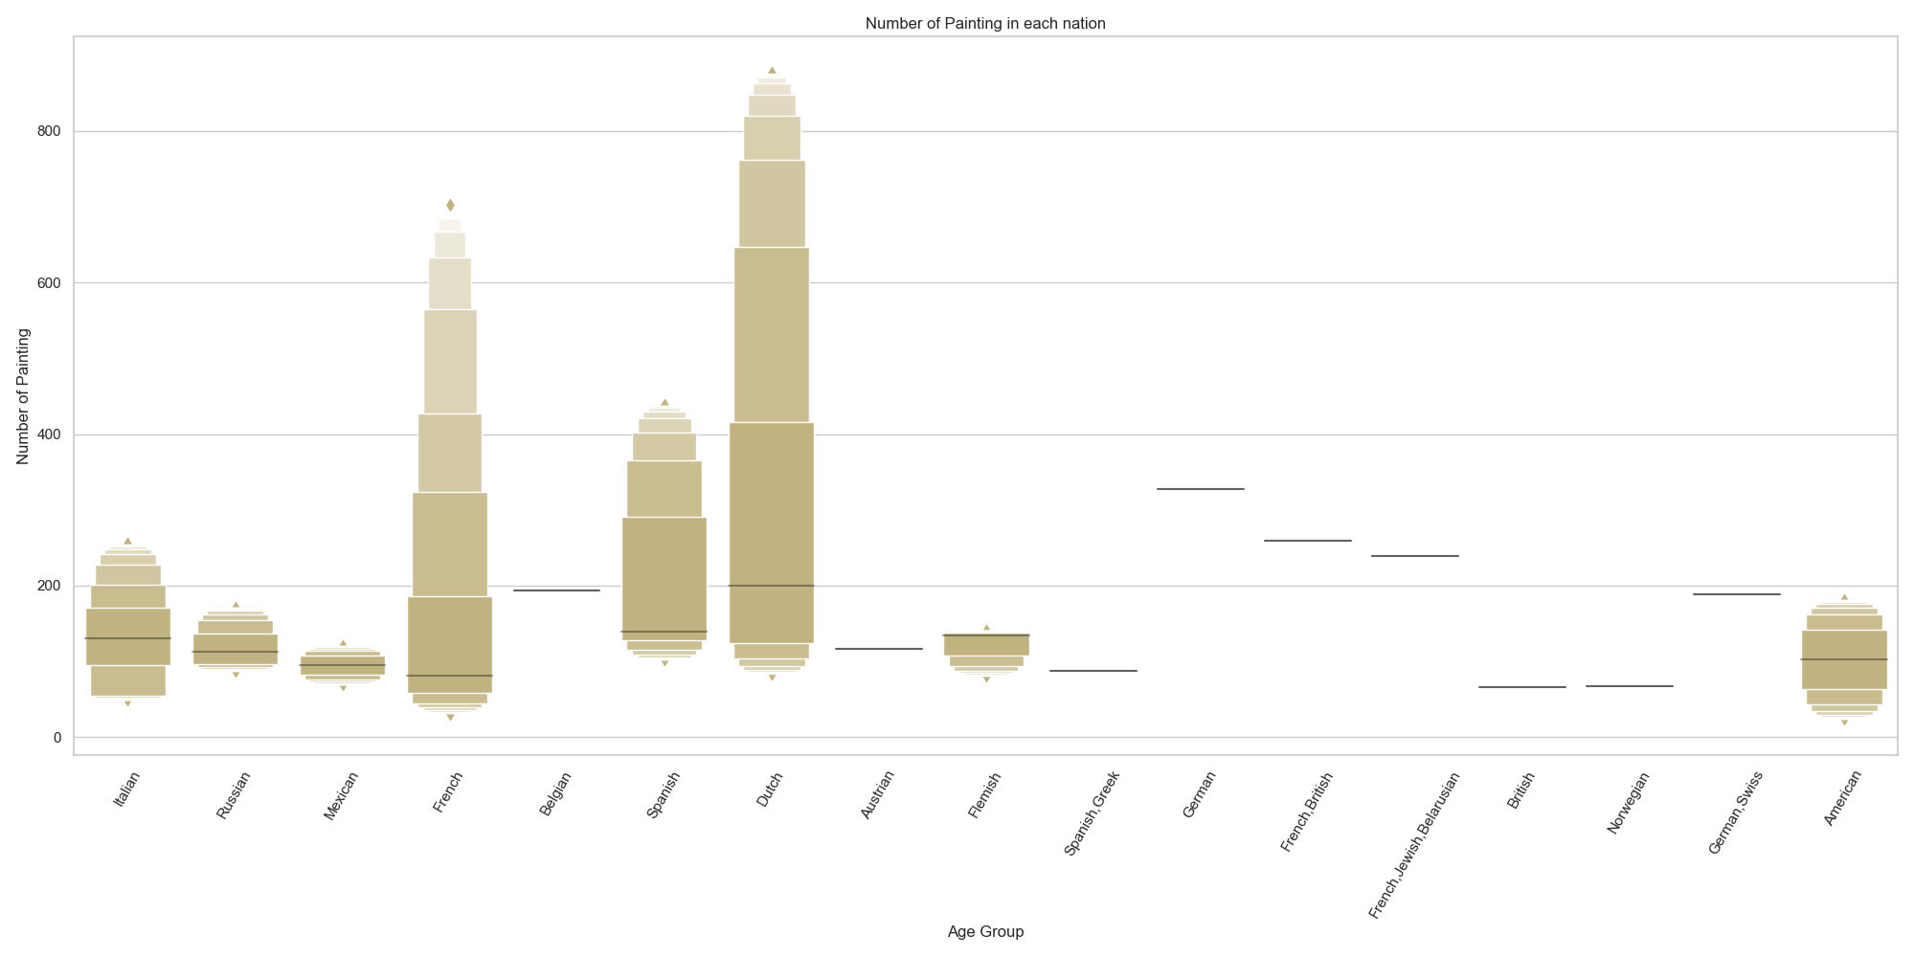
EDA -- Nationality
The top 4 countries with the most famous artists are all European countries, French, Italian, Spanish and Dutch, in such order.
Vincent van Gogh was a Dutch post-impressionist painter and Edgar Degas was French impression aritist. We could tell their nationalities from the 2 longest bars in the following plots.

Slide 8
Problem Statement
Build neural networks to recognize the corresponding artist of painting pictures based on the colors used and geometric patterns inside the pictures.
Data preprocessing
Model building and training
Keras : MLP, ResNet
Pytorch: CNN, VGG16
Networks Testing
Steps

Slide 9
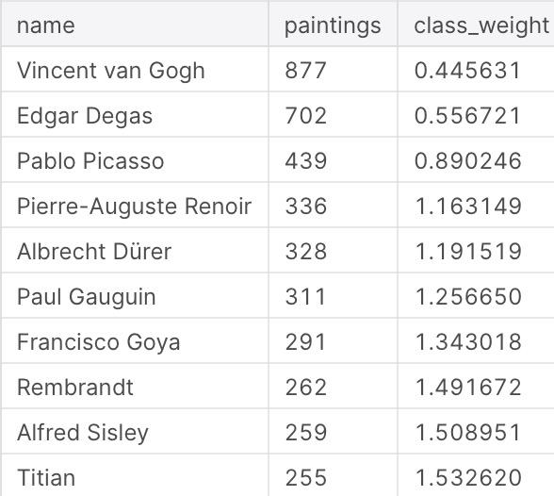
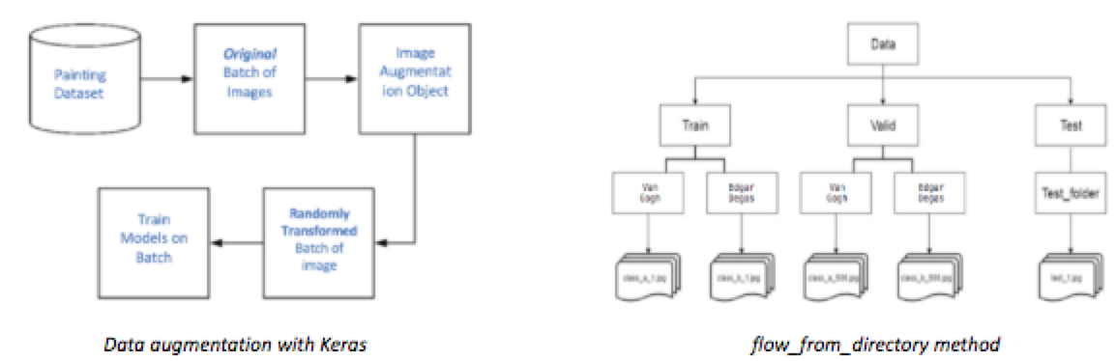
Preprocessing
Only 11 artists have more than 200 paintings in the dataset. To reduce computation and better training, we decided to use the paintings of these top ten popular artists only.
Image Augmentation
Resize
random scaling, cropping and flipping
Flow_from_directory Method
Data split into training, validation and testing datasets with a ratio of 8:1:1.

Slide 10
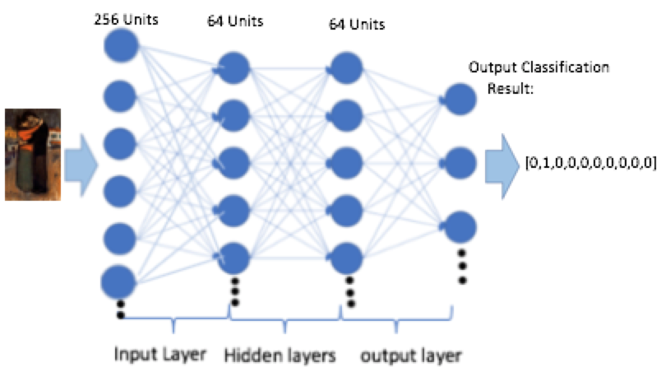
Deep Learning Network -MLP
Three-Layer MLP network

Slide 11
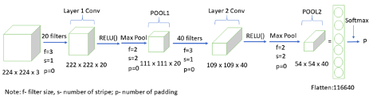
Deep Learning Network- CNN
CNN:
A self defined neural networks based four major functions in the network and created a ArtCNNclass based on master torch.nn.Module class.
torch.nn.Conv2d() – applies convolution
torch.nn.relu() – applies ReLU
torch.nn.MaxPool2d() – applies max pooling
torch.nn.Linear() – fully connected layer (multiply inputs by learned weights)
I created ArtCNN with one class method: forward. The forward() method computes a forward pass of the ArtCNN. (Figure 1)
Figure 1. CNN Network workflow

Slide 12
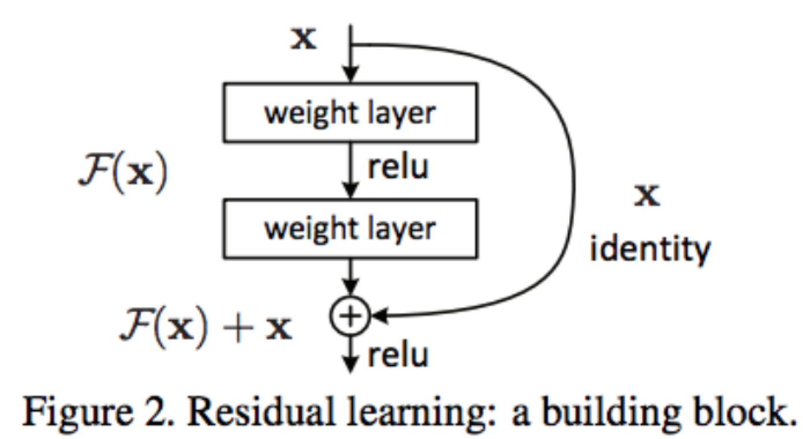
Deep Learning Network-ResNet (Pre-trained)
ResNet: Residual Neural Network (ResNet)
The unique feature of Resnet is the function of "skip connection"between layers, which adding the outputs from previous layers to the outputs of stacked layers. This results in the ability to train much deeper networks.

Slide 13
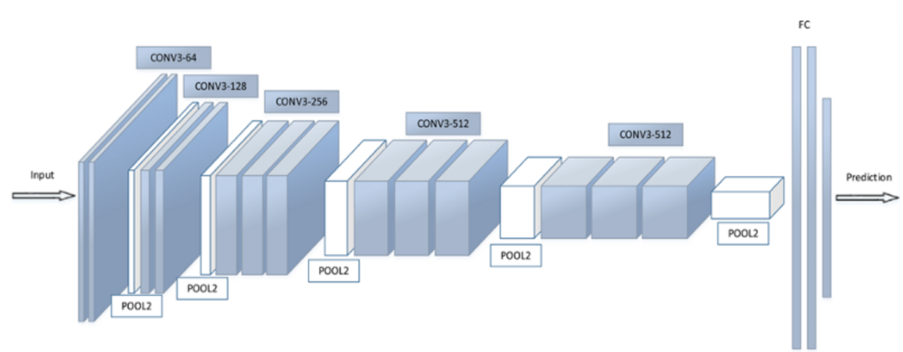
Deep Learning Network -Pretrained Network
VGG16: The second pretrained model VGG16 is utilized to screen the input features , then a new, untrained feed-forward network is used as a classifier, consisting ReLU activations and dropout. During the training, we also only update the weights of the feed-forward network not the model parameters from pretrained model.

Slide 14
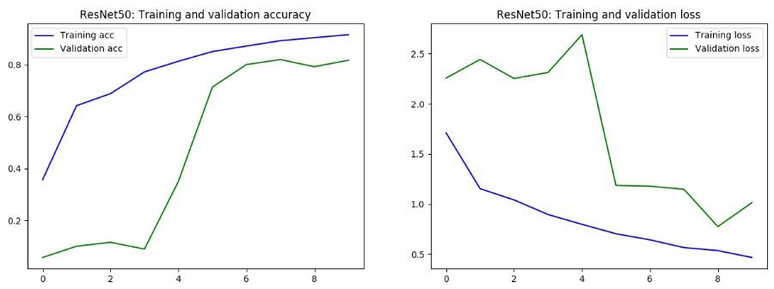
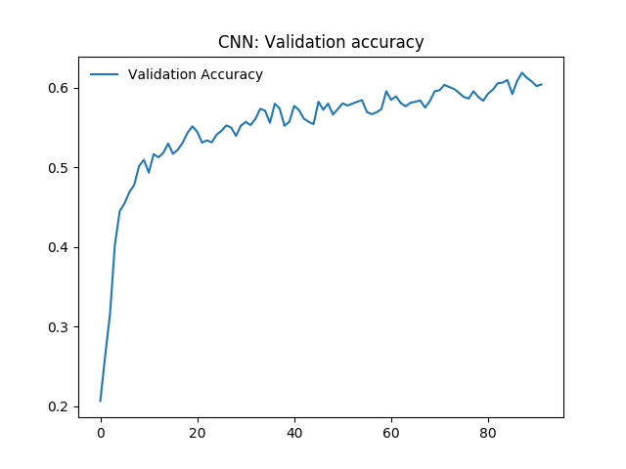
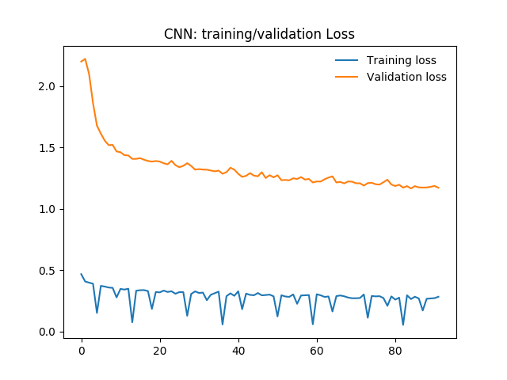
Performance Measurement
ResNet
CNN

Slide 15
Results- Accuracy
Model (Network) | Average Accuracy
MLP | 0.58
CNN | 0.64
VGG16 | 0.81
ResNet | 0.84

Slide 16
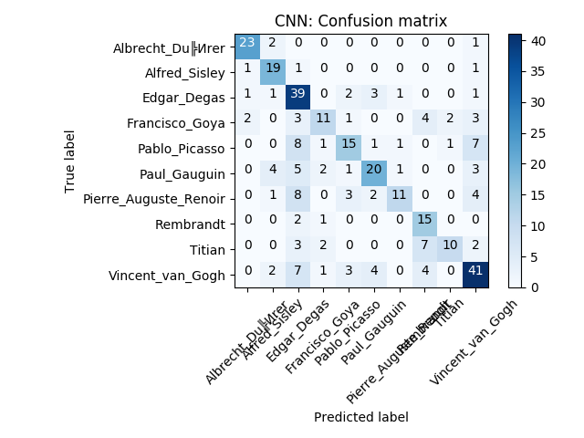
CNN model confusion matrix

Slide 17

VGG model confusion matrix

Slide 18
Conclusion
We successfully built four neural networks that can help us to recognize the artist of a painting pictures based on the colors used and geometric patterns.
Overall, pretrained model has better performance than the self-designed network in terms of accuracy.
We will use the trained network for inference. That is, we will pass a new image into the network and predict the corresponding artist of the painting in the image.
Potentially use text mining from the word document provided in the dataset to help better predict the painting author.

Slide 19
Thank you ! Any Questions?

